Slide 1
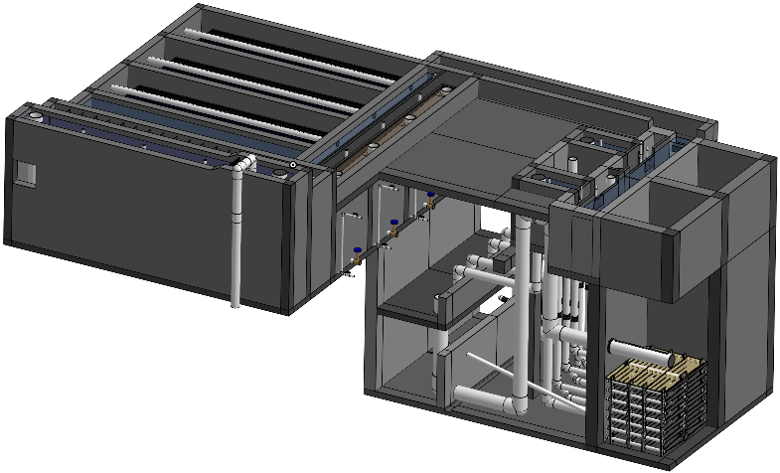
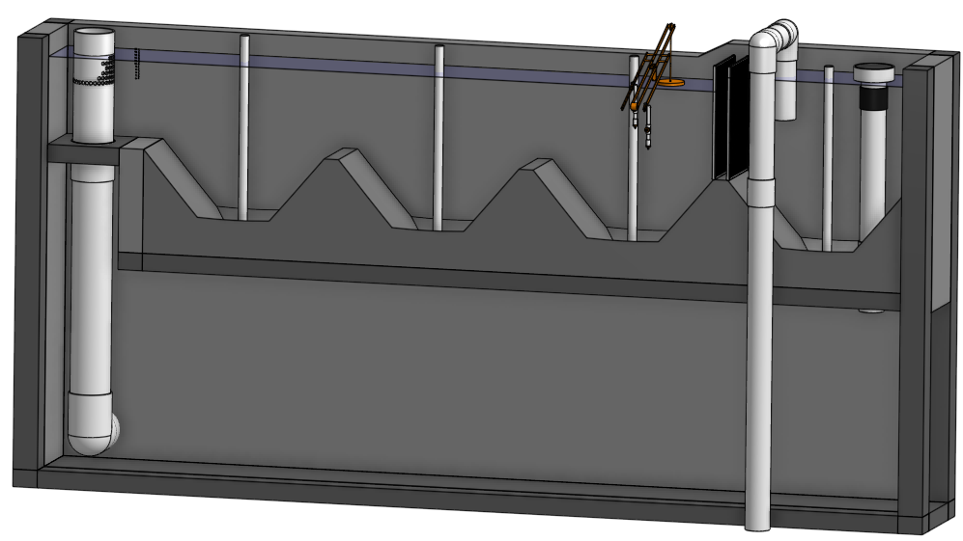
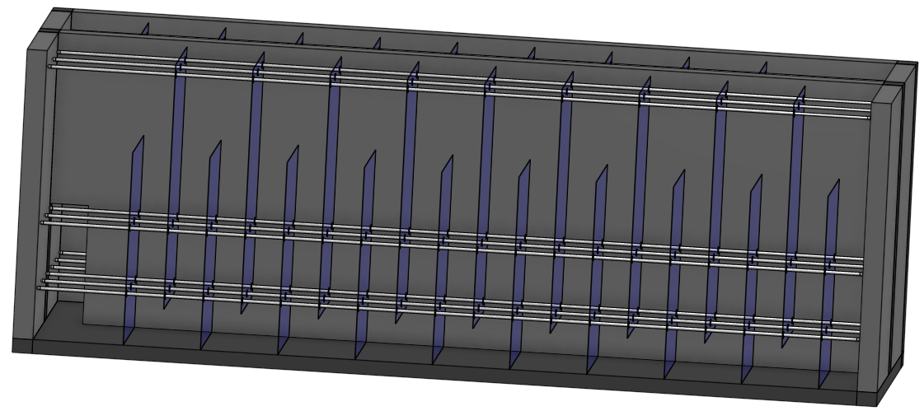
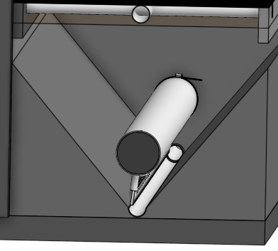
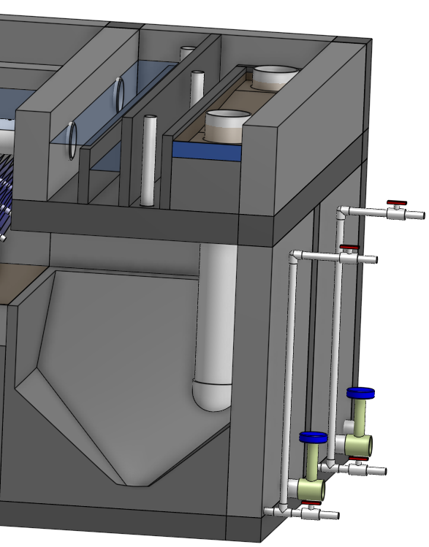
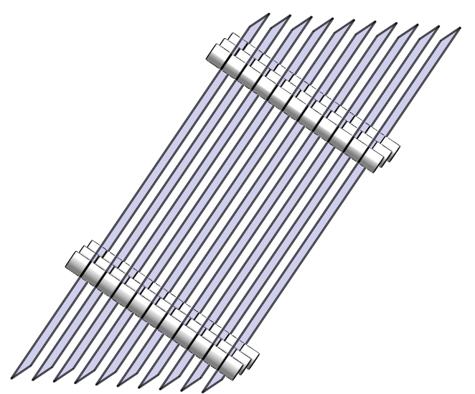
AguaClara Surface Water Treatment
Raw water
Backwash recycle proposed
Screening, grit removal, flow measurement
Stacked Rapid
Sand Filtration
Coagulant
sludge
Backwash water
Cl₂
Hydraulic
Flocculation
Storage
Floc Filter
Distribution
Floc Hopper
Plate Settlers
sludge
Clarifier

Slide 2
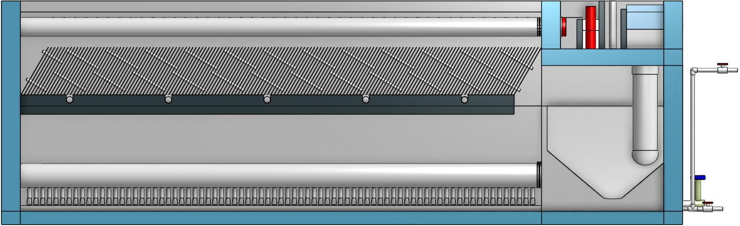

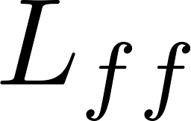
Components of a Clarifier
Outlet manifold
Plate Settlers
Floc hopper
Floc filter
Inlet manifold
Notes:
Why is it called a clarifier?
How does flocculated water get into the clarifier?
How do flocs get from the floc filter into the floc hopper?

Slide 3
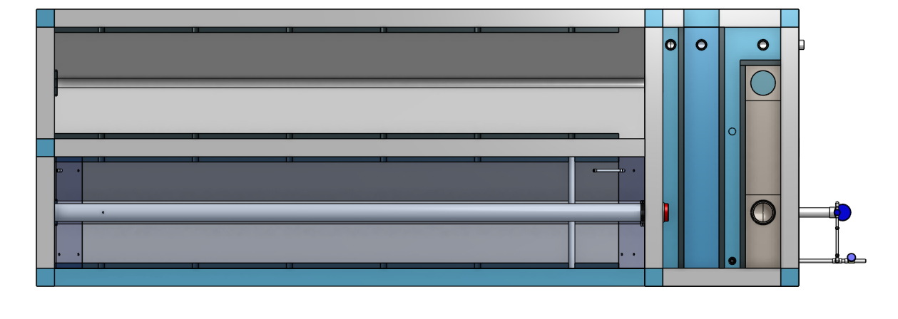
How much space (plan view area) for 1 L/s?
Q=VA! - What is the upflow velocity through the floc filter?
A = Q/V = 0.001 m³/s/(0.001 m/s)

Slide 4
Four sizes/types of Floc
New flocs in the floc filter
Full flocs in the floc filter
Primary particles and flocs too small to be captured by the plate settlers
Flocs that settle fast enough to be captured by the plate settlers but not fast enough to stay in the floc filter

Slide 5
Which of these ISN’T true?
"full" flocs are removed via the floc hopper
primary particles settle out
non-full flocs are removed via the floc hopper
primary particle are captured/filtered by flocs
flocs with terminal velocities lower than the upflow velocity in the clarifier are captured by the plate settlers and avalanche to form flocs that stay in the floc filter

Slide 6


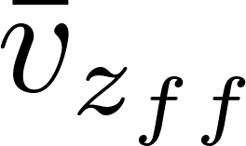
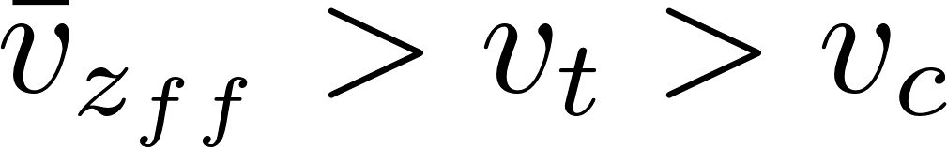
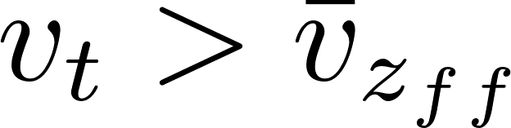
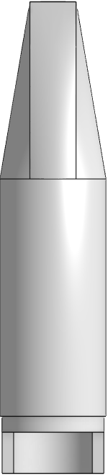
Floc Filter, Plate Settler, Floc Hopper
Effluent manifold
Plate Settlers
 | Terminal Velocity
 |  | 2
 |  | 2
 |  | 2
 |  | >2
Floc Filter
Floc Hopper
Inlet (from flocculator)
Notes:
Story
Big green flocs from flocculator form blue floc filters in the plate settler
Red flocs

Slide 7
Which of these ISN’T true? (break out rooms for 3 minutes – then vote)
"full" flocs are removed via the floc hopper
primary particles settle out
non-full flocs are removed via the floc hopper
primary particle are captured/filtered by flocs
flocs with terminal velocities lower than the upflow velocity in the clarifier are captured by the plate settlers and avalanche to form flocs that stay in the floc filter

Slide 8
Primary particle sedimentation
Primary particles don't settle out because they are in suspension right?
A fast flow river can have sand and even gravel in suspension!
Will primary particles ever settle out in a clarifier?
Why do we flocculate the water?
It is fun
We wanted to be able to see the dirt
To increase the sedimentation velocity
Notes:
Won’t settle out if the water is flowing!

Slide 9
Quiz 31
Explain the difference between flocculation and clarification
How large do flocs get?

Slide 10
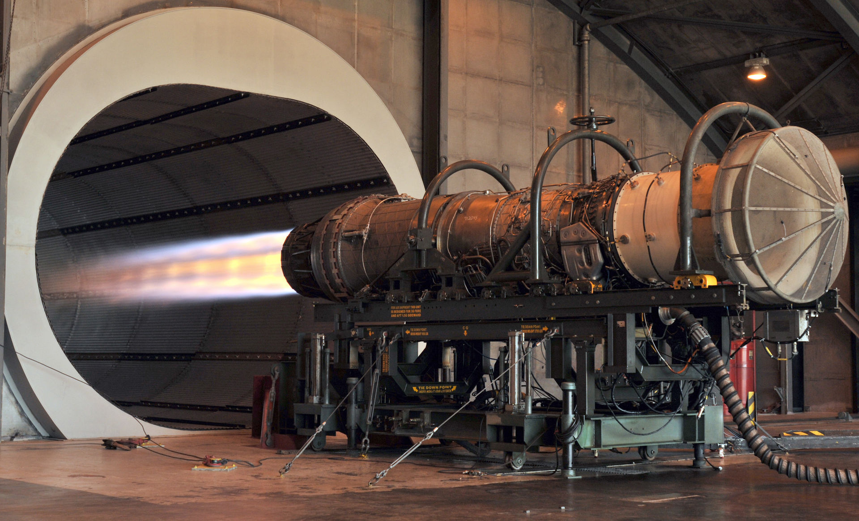
Jet engines create a round fluid jet to generate thrust
By Shelley Gill - 123232730, Public Domain, https://commons.wikimedia.org/w/index.php?curid=12358905

Slide 11
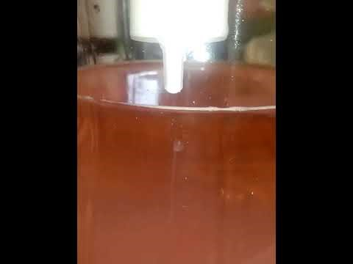
What is a fluid jet?

Slide 12
Floc colors
Can you see the green flocs? Can the plant operators see green flocs?
The colors that I gave to the flocs in the presentation are just to make it easy to talk about them. They aren’t actually those colors. Flocs vary in color from white to brown (from what I’ve seen)

Slide 13
Floc Filter, Plate Settler, Floc Hopper
Effluent manifold
Plate Settlers
 | Terminal Velocity
 |  | 2
 |  | 2
 |  | 2
 |  | >2
Floc Filter
Floc Hopper
Inlet (from flocculator)
Notes:
What is acting like a filter inside the clarifier?
What controls the supply of big blue flocs in the floc filter?
Under what conditions would there be more new big blue flocs entering the floc filter?
What are big blue flocs made from?
Propose 2 methods to increase the supply of big blue flocs.

Slide 14
Prepare to type the answers to questions 4 and 5 in the chat
What is acting like a filter inside the clarifier?
What controls the supply of big blue flocs in the floc filter?
Under what conditions would there be more new big blue flocs entering the floc filter?
What are big blue flocs made from?
See if you can come up with 2 methods to increase the supply of big blue flocs.

Slide 15
How large are these systems?
What do you mean by “large”?
What do you mean by “systems”
What is the context?
How much does the size of these systems vary?
What else do you need to know in order to estimate how large a system will be?

Slide 16
How large is the clarifier for a community?
Define what else you need to know and make up answers for those additional inputs to your calculation.
Rewrite the question so that it is clear and can be answered
Then estimate the plan view area of the clarifier for the question you have crafted
Hints:
You can google to find out how much water people use (it is about 3 mL/s)
Type your question (do this first) and your answer into the jam board

